Slide 1
Sky – platforming
Final

Slide 2
Index
Topic description
In Game Elements
Game Input devices and sensors
Game mechanics
Mappings

Slide 3
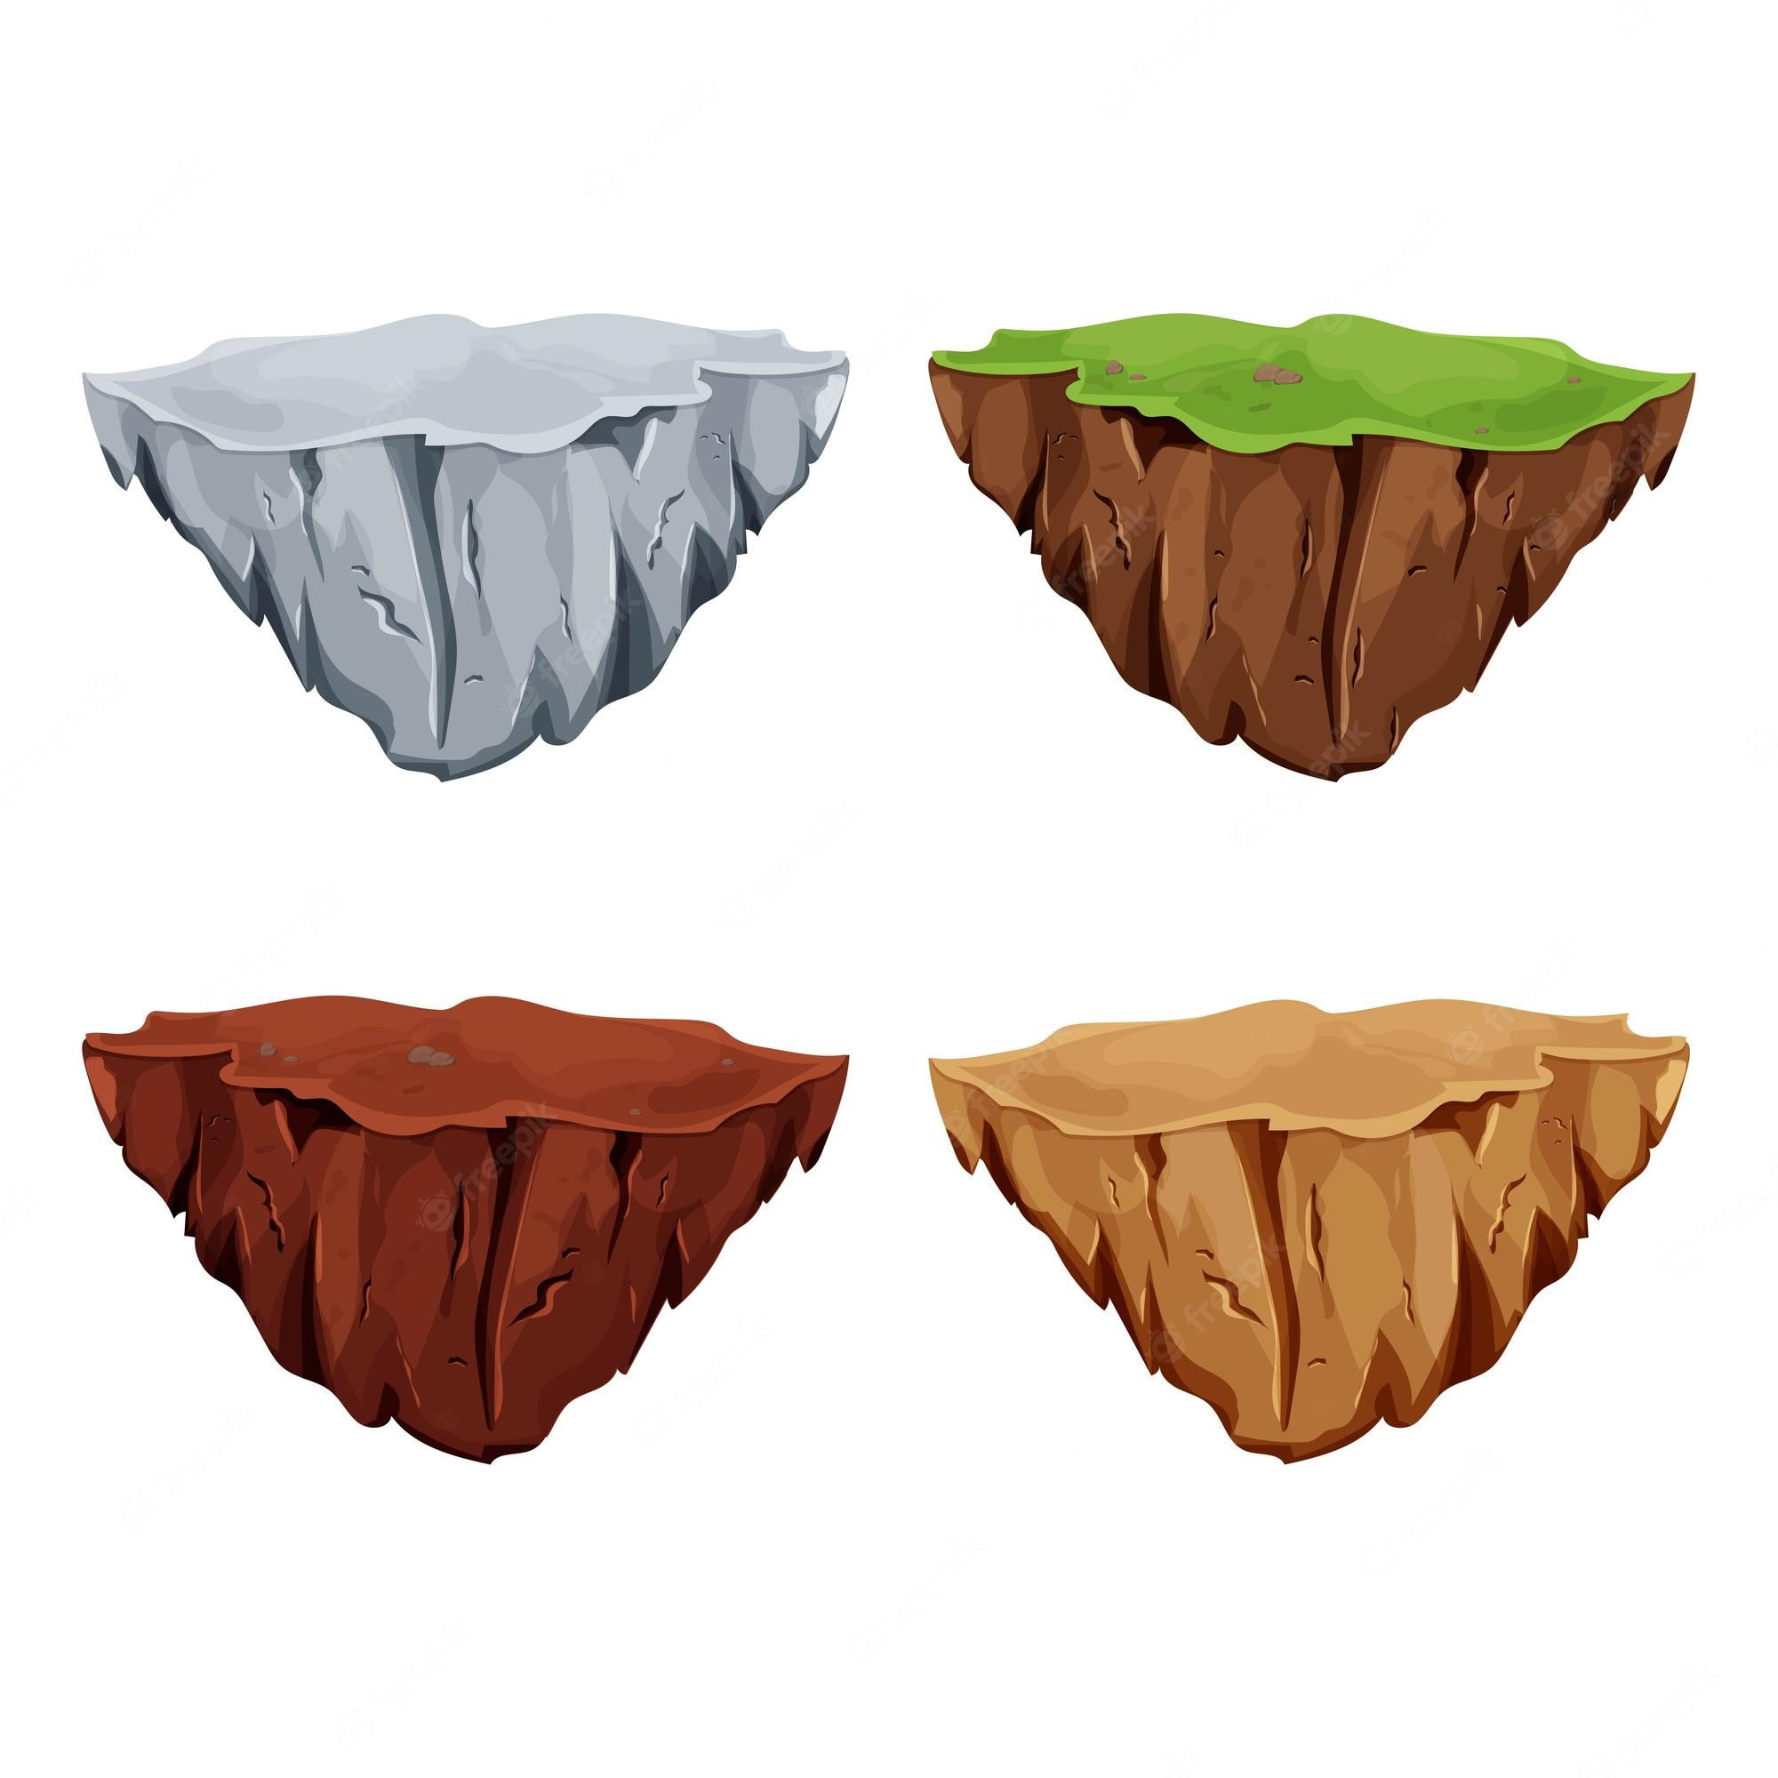
Story and narrative
The game is based on 2 player cooperation in order to advance through the adventure.
Game happens in the sky, where players will move from island to island in order to get to the end of the level

Slide 4
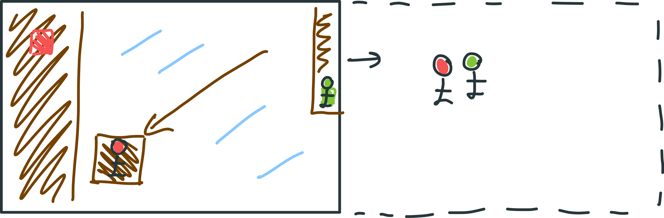
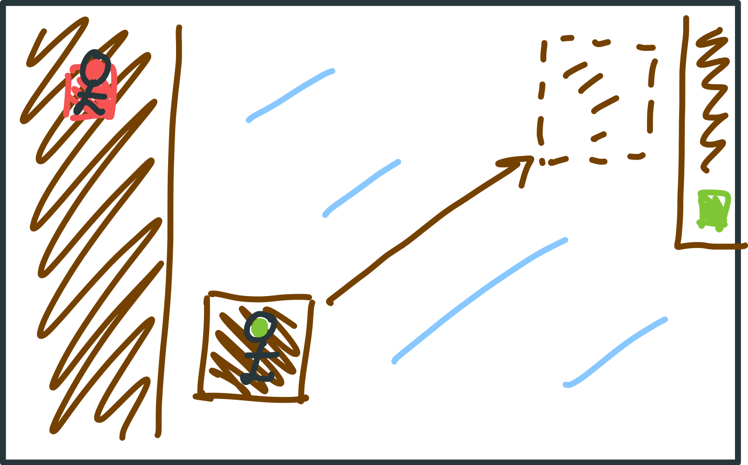
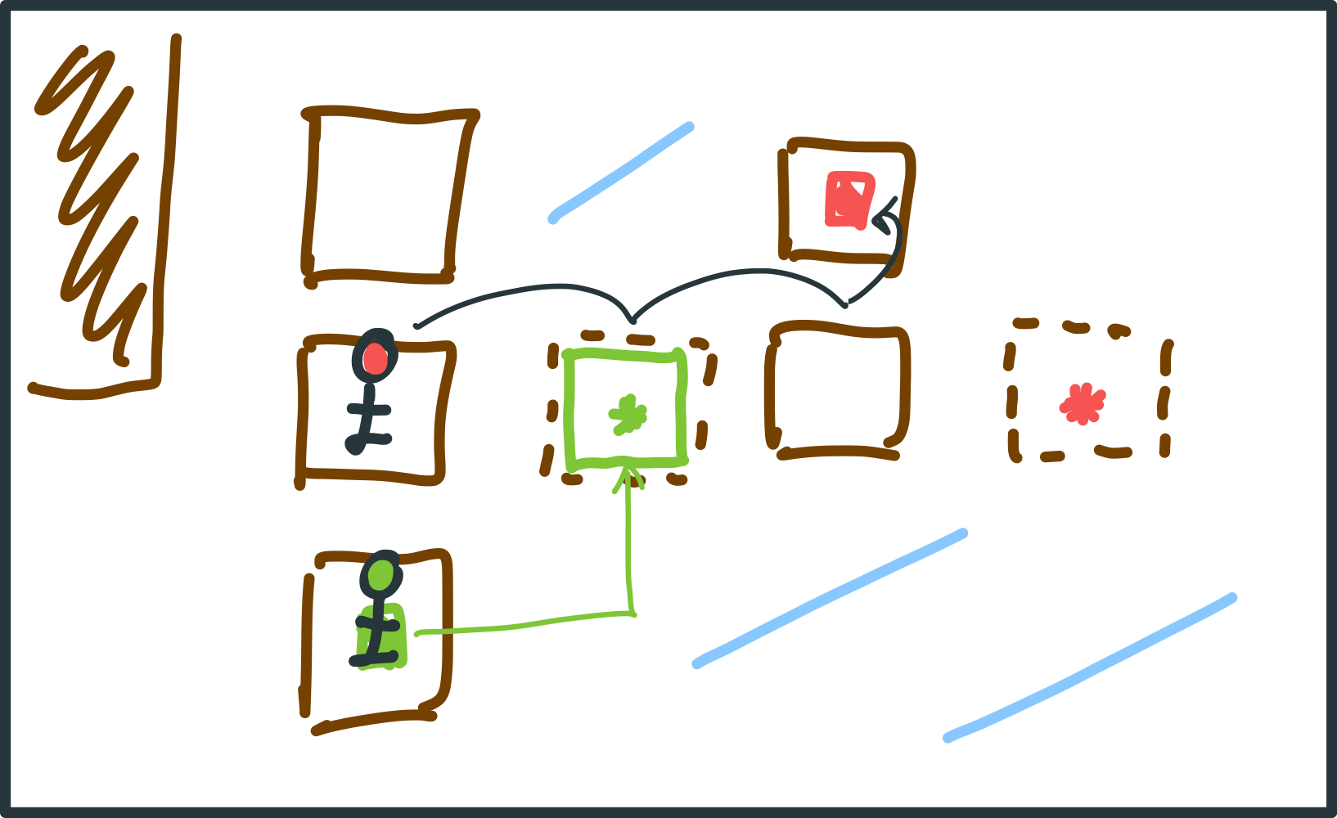
Storyboard
Initial proposal: map displacement during level
Displacement of the platform
Final game: finish level at some point and change everything
4

Slide 5
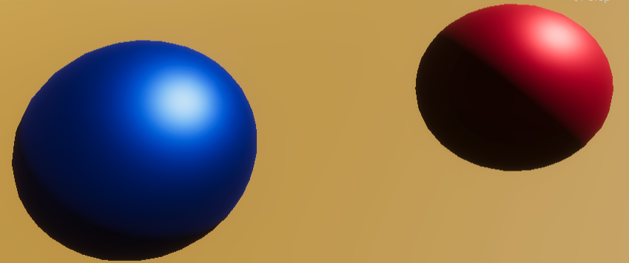
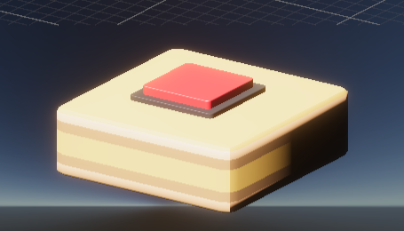
In Game elements
Players: represented by two colored spheres
Island: platforms used to advance through the level
Buttons: will unlock unique movements of a certain platforms

Slide 6
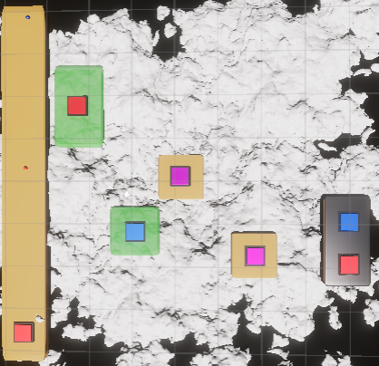
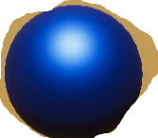
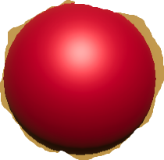
Game elements
Players will be able to interact with their same button color. Given that the sphere will represent the player virtually.
2 types of buttons:
Final platform will need the two players in their respective platform to finish the level and jump to the next one
Blue and red are exclusive to one of the two players, depending on their color
Purple buttons activate only if both players step on it at the same time.

Slide 7
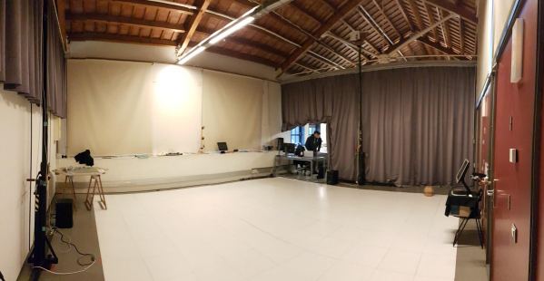
Input devices and sensors
We use UPFuBIntLab provided interactive system. The detection consists on monitoring:
Players’ position (x,y,z cords.)
  Displacement (x,y)
Placing of the sensor (in each player):
In the foot to allow movement (left & right)

Slide 8
Mappings
Input mappings:
Take 3D coordinates from the trackers to 3D coordinates in Unity
! ! → Some transforms needed in order to match the same position
( due to tracker and sensors positioning )
Output mappings:
Output 3D Unity coordinates into 2D screen (projectors in this case)
8

Slide 9
Mappings
Positioning respect to the tracker position:
2 different cases:
- Playing on platforms: x, y, z coordinates are followed to place the virtual player in the same position
- Falling from the platforms: the y coordinate is omitted and gravity is applied to create the falling effect.
(The cameras also updates their position to generate the effect)
10

Slide 10
Thanks!
Any questions?
Find us at:
sergi.vila02@estudiant.upf.edu
josep.sala01@estudiant.upf.edu
pau.segales01@estudiant.upf.edu

